Slide 1
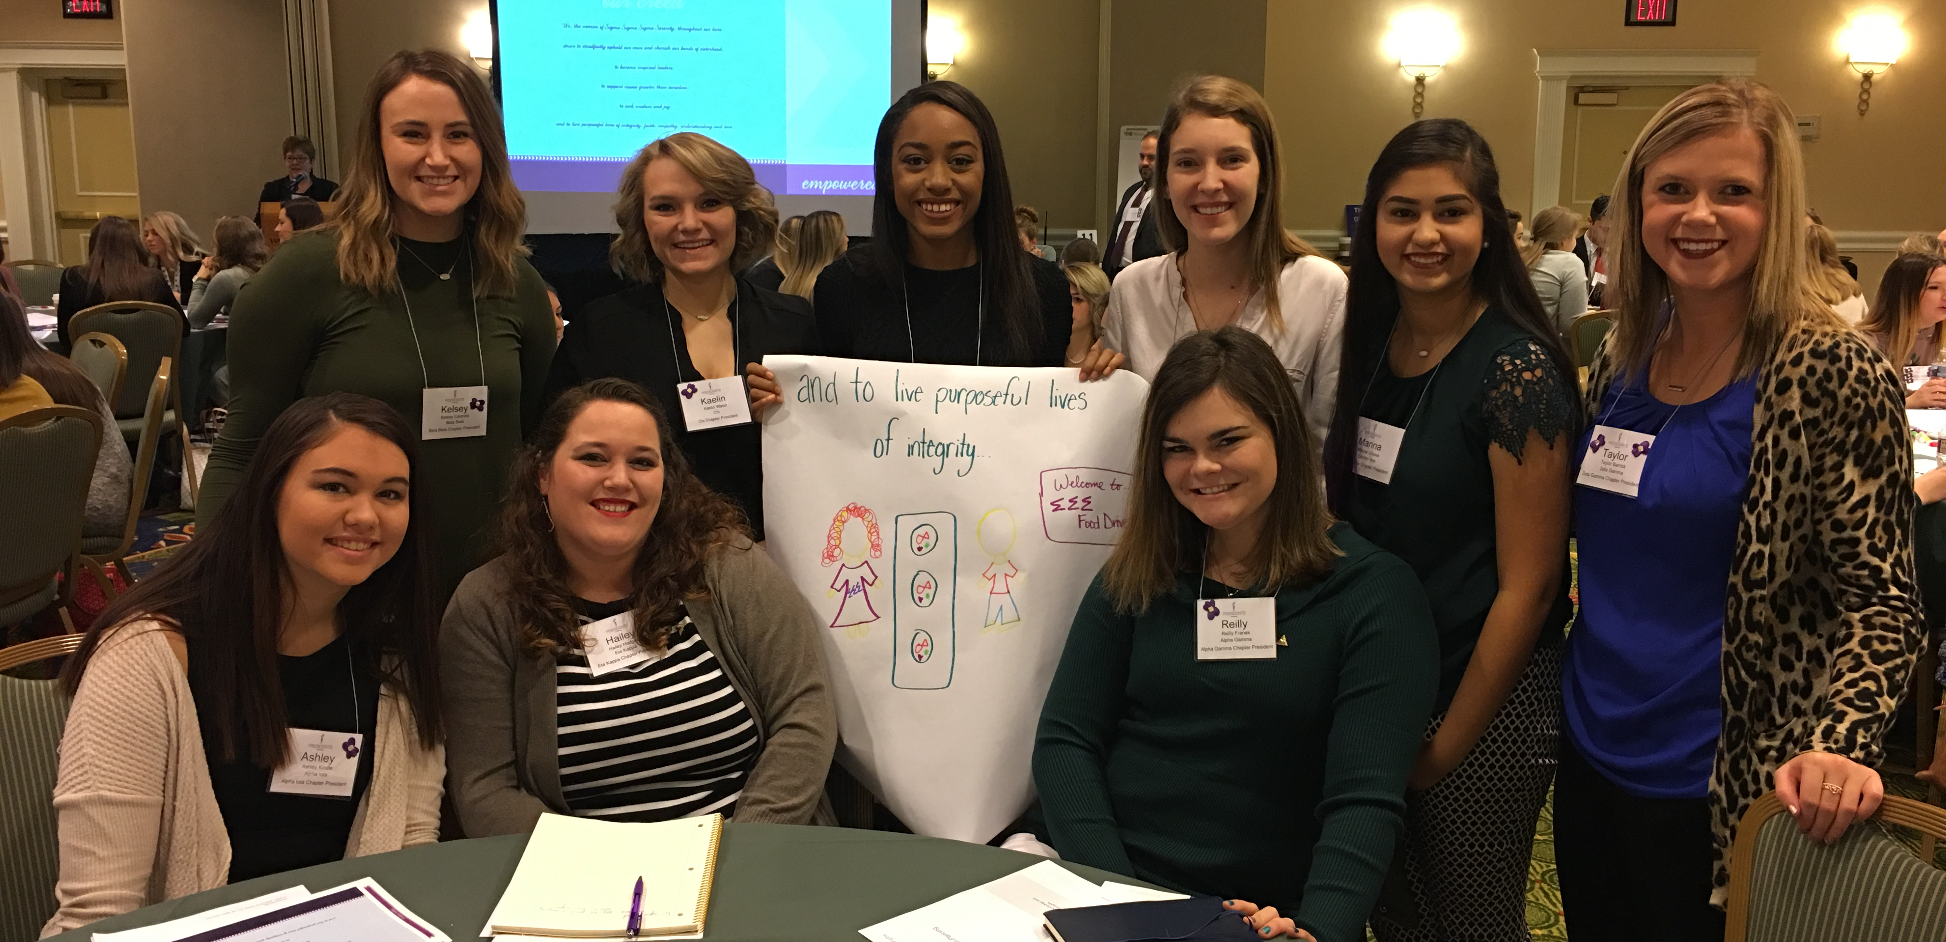
Lucy’s Legacy Undergraduate Giving Club| 2018
Notes:
Welcome to the Tri Sigma Foundation’s webinar/presentation for Lucy’s Legacy Undergraduate Giving Club. Let me start off by telling you a little bit about myself. My name is [insert] and I am a Foundation Collegiate Ambassador/Foundation Chair. [Insert a brief bio of yourself, which may include your initiation chapter, university, currently held leadership positions, major, etc.]
The Collegiate Ambassadors are advocates and educators for Lucy’s Legacy and the Foundation’s mission. One way all Tri Sigmas across the country on university and college campuses can support the Foundation’s mission is by making philanthropy an important part of who we are as Sigmas. One thing I have learned as an Ambassador is there are many ways we can support our Foundation and Lucy’s Legacy helps us discover those ways to get involved.
So today I am excited to share how you and your chapter can join Lucy’s Legacy.

Slide 2
What is Lucy’s Legacy?
Lucy’s Legacy is the Foundation’s undergraduate giving club.
Inspired by Founder and natural-born leader, Lucy Wright.
You are Lucy’s Legacy!
Notes:
Your chapter may have its annual philanthropy fundraiser, such as Sigma Night Live or your Violet Gala, but Lucy’s Legacy is about how we as individuals can support the Foundation. The Foundation has many giving clubs and societies for its donors and Lucy’s Legacy is specifically built for us as undergraduates.
Inspired by Lucy Wright, one of our eight founders. Lucy was described in our history book as a natural-born leader. If the founders had officer positions back then, she most likely would have been the chapter President. She was known for being involved on campus, including sports, service and social activities. Our undergraduate giving club was named after her because you (we) are Lucy’s Legacy. As chapter and campus leaders, we have the opportunity to build a stronger Foundation to support Tri Sigmas now and in the future.

Slide 3
Why is Lucy’s Legacy Important?
Lucy’s Legacy gifts are unrestricted gifts, meaning they impact Tri Sigma’s leadership and education programs
Offers Achievements and annual Challenges to support scholarships, leadership development, and Sigma Serves Children
Honors one of our eight founders by continuing her legacy of leadership
Notes:
Lucy’s Legacy started in January 2017. So it is still a newer program and we are excited to have you help lead the way for your future chapter members. So why is Lucy’s Legacy important?
The Foundation discovered that many Tri Sigma members were graduating and didn’t know how to make their annual gift to the Foundation, or sometimes didn’t even know the three pillars to the Foundation mission. Lucy’s Legacy was a response to better support our collegiate chapters and celebrate our members for their individual philanthropy.
With gifts through Lucy’s Legacy, you help fund Tri Sigma’s impactful leadership and educational programs like President’s Academy, Dunham Women of Character, Prevention Institute, Labyrinth Leadership Experience and many more. The club offers achievements and challenges to support scholarships, leadership development and Sigma Serves Children. And it continues to honor Lucy Wright and her legacy of leadership.
___________________________________
Additional notes about leadership and educational programs (more information can be found on the website):
The Presidents Academy is a new National program for chapter presidents to learn and lead using the values of Tri Sigma as their guide. Participants will develop valuable leadership skills, receive education on current issues relevant to collegiate women, and establish a network of support that will empower them to create meaningful change in their chapter and community that is consistent with the mission, vision, and values of the Organization. The Academy debuted in January 2017.
Dunham Women of Character Institute focuses on the education of our newer/younger members and is designed to empower emerging leaders to lead with character.
The Prevention Institute focuses on Partnerships in Prevention. This is an educational opportunity emphasizing the necessary partnership between members, National Headquarters, volunteers, advisors, and college/university partners to ensure safety for all members. Attendees will develop skills with the goal of empowering members to confront high risk behaviors but more importantly how to proactively identify risky behaviors and reduce the potential for harm.
For the Tri Sigma who yearns to learn and live our mission, vision and values, the Labyrinth Leadership Experience provides a transformational, engaging and inter-generational experience for members to grow in their appreciation of the lifelong commitment associated with membership.
Featuring both domestic and international opportunities, the service immersion trips are intergenerational experiences that allow members to strengthen their commitment to volunteerism. Each experience provides a hands-on opportunity to explore personal identity, diversity, and social justice, which are crucial elements of empowering our members to change the world.
Education Summit, hosted only in March 2018, is a program designed for Education Directors and Scholarship Advisers to provide training and resources for impactful chapter programming.

Slide 4
Join Lucy’s Legacy
Make an individual gift of $18.98 at trisigma.org/donate to join.
After joining, you’ll be a member for your entire undergraduate years!
Participate in different levels of your individual philanthropy and earn incentives, such as an annual t-shirt, water bottles, hats and more.
Notes:
Now that you know about why Lucy’s Legacy is important, let’s talk about how you join.
It’s simple to join. You make an individual gift of $18.98 at trisigma.org/donate (on the Tri Sigma website). The nice thing about joining Lucy’s Legacy is that you remain a Lucy’s Legacy member until you become an alumna or go through Circle Degree.
So you join once and you will remain on the honor roll listed on the Foundation website and our Annual Report until you graduate. After you join, you can choose how you participate in Lucy’s Legacy and earn incentives, such as our annual Lucy’s Legacy t-shirt.

Slide 5
Notes:
You may have heard me mention ”achievements.” Here is the PDF that is available to your chapter that highlights the different ACHIEVEMENTS members can complete each semester to PARTICIPATE in Lucy’s Legacy.
It very much looks like bingo. The center is the first gift of $18.98 you make to join Lucy’s Legacy. It’s highlighted differently because remember you only have to do that once. Every semester you complete one of the other ACHIEVEMENTS, you get credit towards PARTICIPATING in Lucy’s Legacy. You can choose to do the same ACHIVEMENT every semester or choose a different ACHIEVEMENT (and try to complete all before your graduation).
Let me tell you how I am choosing to participate in Lucy’s Legacy…[insert which ACHIEVEMENTS you are striving to complete this academic year].
Example if needed:
I joined Lucy’s Legacy in spring 2017 with my first gift of $18.98. This semester I get credit for serving as a Foundation Ambassador. While I will also get credit for serving as a Foundation Ambassador next spring, I am working on saving money so I can plan to make a larger donation of $20 (or more if I can) during my chapter’s Founders Day celebration in April.
The fun thing about Lucy’s Legacy is for every three ACHIEVEMENTS you complete, you will receive a gift from the Foundation for your generosity and support. There are both financial and non-financial ACHIEVEMENTS part of Lucy’s Legacy because again it takes both giving of our time and treasure to serve the Foundation’s mission.
If your chapter is striving to meet the Accreditation Pillar associated with Lucy’s Legacy (Pillar 4), your chapter also has the opportunity to get the commemorative annual t-shirt for all chapter members who join.

Slide 6
Example: Honor 5 Sigma Sisters with Violet Tributes
Visit violettributes.com, click “Give a Violet Tribute” fill out form 5 times to send Violet Tributes to Sigma sisters. Your gifts are recorded by the Foundation which gives you credit for your annual and lifetime giving.
Notes:
Let me take you through two of Lucy’s Legacy ACHIVEMENTS.
One way to participate in Lucy’s Legacy after you join can be to honor 5 Sigma sisters with Violet Tributes. If you don’t know what a Violet Tribute is, it is a gift of $5 to the Foundation in honor of another person. You make the $5 gift online at violettributes.com and can send a personalized message to the person you are honoring. The website allows you to send all 5 at the same time. If you cannot make a gift of $25 at one time, you can send one (which is a $5 gift) each month for an entire semester until you complete all five.
It’s like skipping Starbucks for one day a month and instead supporting the Foundation and sending love to a Sigma (near or far).

Slide 7
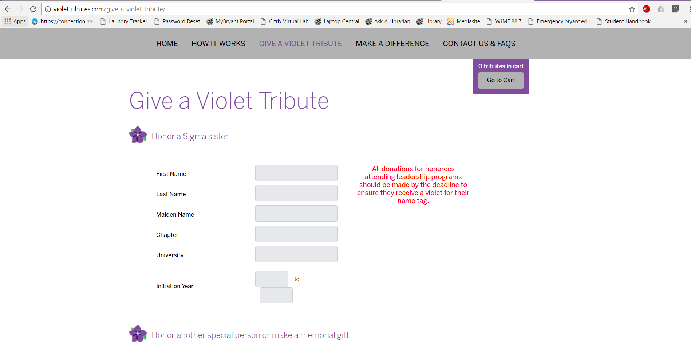
Notes:
Here is what the give page looks like on the Violet Tributes website. You are able to search for Sigma sisters both collegiate and alumnae by first name, last name, chapter, and university. Once you find who you want to honor, you select their name and add them to the cart. You can make your gift online with a debit or credit card. Again, you can make the multiple gifts or just one $5 gift at a time.

Slide 8
Example: Volunteer for March of Dimes
After volunteering for March of Dimes, which could include your chapter hosting a Bubble Zone at March for Babies, fill out the Lucy’s Legacy achievement form at https://www.trisigma.org/lucys-legacy-faqs
Notes:
Another way to participate in Lucy’s Legacy is by supporting our national philanthropic partnership with March of Dimes. One reason Tri Sigma and March of Dimes was the perfect pairing for a partnership was because Tri Sigmas continue to seek service opportunities in our communities. Through March of Dimes, members can volunteer at your local March of Dimes office or at one of their events such as a Signature Chef Auction, Military Baby Shower or their largest and most well-known event March for Babies walk.
This is an example of a non-financial ACHIEVEMENT that members can do to participate in Lucy’s Legacy if they are unable to make a monetary gift. And this can be accomplished either fall or spring semester. There are local MOD officers, staff, and representatives all across the country. If your chapter is interested in connecting to a volunteer opportunity or finding your local office, you can find those resources on the Foundation website.
A chapter hosting a Bubble Zone at a March for Babies walk or campus/community event is another great way for members to volunteer to serve and raise awareness for the March of Dimes mission. If a member wants more information about Bubble Zone, provide or direct them to the PDF Bubble Zone Guide.
While the Foundation does it’s best to keep track of all Lucy’s Legacy achievements, we are unable at this time to accurately track all Tri Sigma volunteer hours with MOD. We ask that you submit the online form if you volunteer for March of Dimes to ensure you get credit for Lucy’s Legacy.

Slide 9
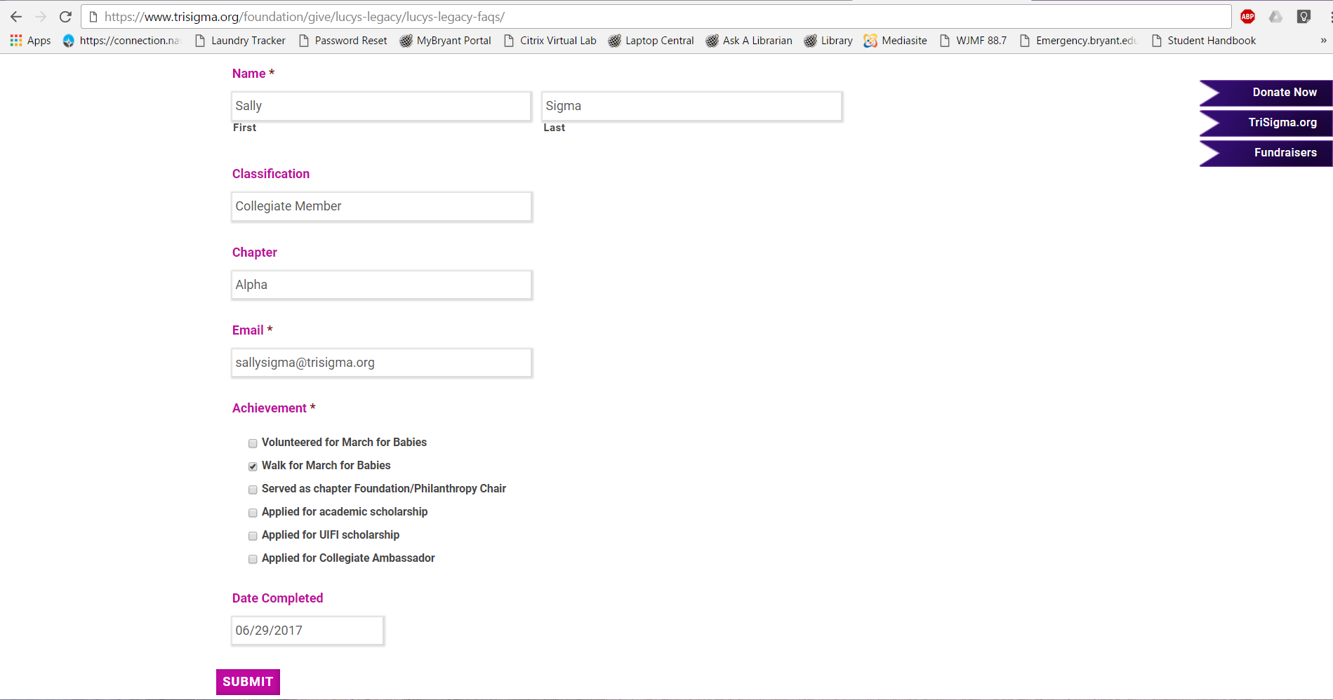
Notes:
Again you can fill out the Lucy’s Legacy achievement form at https://www.trisigma.org/lucys-legacy-faqs. It’s a simple form that you much include your full name, email and mark the date that you volunteered for MOD.

Slide 10
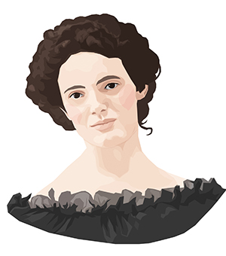
Questions?
Contact Desiree at foundation@trisigma.org
Or visit trisigma.org/lucys-legacy
Notes:
Desiree Paulhamus, Director of Chapter Fundraising for the Foundation, is a resource to the chapter. I will use the last 5-10 minutes to answer any questions you have about Lucy’s Legacy. I will do my best to answer what I can and if I don’t have the answer for you now, I’m happy to follow-up with Desiree and find the answer for you.
(Edit slide to include your name and contact information if it makes more sense.)
[Q&A portion. If you want to prepare yourself, Frequently Asked Questions can be found on the website at https://www.trisigma.org/lucys-legacy-faqs]
Thank you everyone for joining me today for this webinar! I am a resource to you if you have any questions. I hope you all consider joining Lucy’s Legacy and continue to support the Tri Sigma Foundation.

Slide 11
Thank you for your generosity!
Notes:
Thanks to sisters like you and your support, the Foundation mission is made possible!

